Slide 1

IS Operations & Business Resilience
Information Systems Auditing
Class V

Slide 2
Class Recap

Slide 3
Class Roadmap
IT Governance: Concept
IT Governance: Audit Program
IS Acquisition and Development
IS Implementation
IS Operation & Business Resilience
Protection of Information Assets I
Protection of Information Assets II
Mid-Term Exam
Basic of Data Analysis
Risk and Control
Parallel Simulation
Analytics and Sampling
Substantive Testing: Sales Cycle
Substantive Testing: Expenditure Cycle
Audit Report
Final Exam

Slide 4
Covered So Far
IT Governance in concept
IT Governance through COBIT 2019 standard
Using COBIT 2019 as a criteria for IT Governance Audit
How Systems are Acquired & Developed
How Systems are Implemented
Remember, the first half of this class will cover domains in CISA Review, as follows:
IS Auditing Process
IT Governance
IS Acquisition, Development, and Implementation
IS Operations and Business Resilience
Protection of Information and Assets

Slide 5


My Reflection on Your Reflection
The quiz pressure
Full passive class
Difficult material
Quiz methods
Diverse media
Interactive

Slide 6
Intro: Why This Topic Matters
IS Operations
Business Resilience
Auditor Responsibilities

Slide 7
Intro
#operations #continuity #resilience

Slide 8
Let’s Try Something Different (again)
Today's session involves a graded group activity. Please follow these guidelines closely:
Detail | Instruction
Form Groups | Organize yourselves into small groups of 4 to 5 people each.
Individual Submission | You must individually answer the questions using the Wayground platform. Ensure you have a steady internet connection.
Discussion Rule | You are permitted to discuss the questions and solutions only with members of your current group.
Scoring | Points are awarded based on both correctness and speed. A higher score is given to those who answer accurately and quickly.
Impact on Grade | The average score of your group will be calculated and counted as a component of your overall activity score for this course.

Slide 9
Rule of the Game
You can use AI in this class, EXCEPT to answer the questions given
You can use CISA Review Manual and/or this class slides to find the answer
This is only fun with fairness
So, please do not lie

Slide 10
a + b = 100 a/b = 4 a = ?
Trial Question
Next questions will be related to Domain 4.
But you won't know when and where the question will pop up
1
2
3
4

Slide 11
What is it about?
This chapter explains how an organization keeps its IT running every day and how it continues running when things go wrong.
In simple terms:
IS Operations = keeping the lights on
Business Resilience = making sure the lights come back on if they ever go out
CISA wants us to understand two big ideas:
Operations must be controlled so systems run correctly and reliably.
The business must stay alive even when disrupted—disaster, outage, or failure.

Slide 12
Why It Matters
This chapter connects with last week’s topic on risk & control:
If operational controls are weak, operational risks increase.
If resilience planning is weak, downtime becomes catastrophic.

Slide 13
Normal Conditions → “Daily Life”
How IT works day-to-day:
Processing jobs
Managing data
Handling incidents
Making changes safely
Keeping systems available
Analogy:
the “daily kitchen routine”—everything must be organized, controlled, and consistent to produce the same quality every day.

Slide 14
Abnormal Conditions → “Emergency Mode”
How the organization survives disruptions:
Disaster recovery
Backup & restore
Continuity planning
Crisis management
Analogy:
the “emergency plan” when the kitchen catches fire but the restaurant still needs to serve customers.

Slide 15
Auditor’s Concern
IS auditors must know:
which controls should exist in operations
how incidents and changes should be managed
what backup and restore evidence looks like
how to assess BCP/DRP completeness
whether recovery strategies meet business needs

Slide 16
IS Operations
#goingWell

Slide 17
CISA Focus Areas
Data Input
Processing
Output
Job scheduling & workload
Incident & problem management
Change & configuration management
Backup & Restore

Slide 18
Input Controls (Before Processing)
Ensure only valid, authorized, complete data enters the system.
Types of controls:
Validation rules (format, range, completeness)
Edit checks (check digits, matching fields)
Authorization for batch uploads
Pre-numbered forms
Online field checks
Why auditors care:
Bad input = bad output, regardless of how perfect the system is.

Slide 19
Output Controls (After Processing)
Ensure output is accurate, delivered correctly, and protected.
CISA-related controls:
Distribution lists
Secure report access
Reconciliation to input
Review by authorized users
Logging who received what
Why auditors care: A perfect process still fails if output goes to the wrong person or is misunderstood.

Slide 20
Job Scheduling & Workload Management
Ensure all IT jobs run in the correct sequence, on time, and without resource conflict.
CISA areas to cover:
Scheduling tools
Prioritizing critical jobs
Managing dependencies
Monitoring failed jobs
Documented restart procedures
Capacity & performance oversight
Analogy:
Like airport runway scheduling—wrong order causes delays everywhere.
Auditor focus:
Evidence of monitoring
Logs of failed/restarted jobs
Proper handling of peak workload

Slide 21
Incident Management
Ensure changes are controlled, tested, approved, and traceable.
CISA-required components:
Change request form
Impact analysis
Testing in non-prod
Approval workflow
Scheduling in maintenance window
Backout/rollback plan
Documentation
Segregation of duties (developer ≠ deployer)
Auditor focus:
Check sample changes for:
Approval
test evidence
Logs
SoD.

Slide 22
Configuration Management
Keep track of what exists in the environment (systems, versions, hardware).
CISA elements:
CMDB (Configuration Management Database)
Baseline configurations
Version control
Patch levels
Hardware/software inventories
Mapping dependencies between components
Analogy:
CMDB = the inventory list of an entire IT “warehouse”.
Auditor focus:
Compare CMDB vs actual environment → identify mismatches.

Slide 23
Backup & Restore
Keep track of what exists in the environment (systems, versions, hardware).
CISA priorities:
Backup frequency
Backup type (full, incremental, differential)
Storage (on-site, off-site, cloud)
Encryption & access control
Retention policy
Restore testing (most crucial!)
Analogy:
Backup = insurance | Restore test = claiming insurance to confirm it actually works.
Auditor focus:
Evidence of backup success logs
Evidence of restore tests
Alignment with RPO/RTO

Slide 24
Business Resilience
#continuity #recovery #disruption #resilience

Slide 25
Why Business Resilience Matters
Organizations rely heavily on technology → downtime = financial loss, compliance risk, reputation damage
Threats increasing: cyberattacks, system failures, human errors, natural disasters
IS auditors ensure plans exist, controls work, and management can recover
Aligns with CISA domains on availability, continuity, and risk mitigation

Slide 26
Business Continuity (BC)
Focus: Maintaining critical business functions during a disruption.
Key Questions:
What processes must continue at all costs?
How quickly must they recover?
What resources do they rely on?
Analogy:
If your house loses electricity, BC is your generator keeping the essentials alive.

Slide 27
Disaster Recovery (DR)
Focus: Recovering IT systems, data, and infrastructure after a major incident.
Includes:
Backup strategy
Alternate processing sites
Restoration procedures
Failover and failback operations
Analogy:
If BC is the generator, DR is the electrician fixing the entire power system.

Slide 28
IT Service Continuity (ITSC)
Focus: Ensure IT services remain available or restored within acceptable time.
CISA Emphasis:
Integration with business priorities
Alignment with service-level agreements (SLA)
IT capabilities must match business recovery requirements
Analogy:
Like ensuring your phone network stays up even when one tower goes down — rerouting keeps service alive.

Slide 29
Business Impact Analysis (BIA)
BIA identifies:
Critical processes
Dependencies (people, tech, data, vendors)
Impact of downtime (financial, operational, reputational)
Recovery requirements (RTO, RPO, etc.)

Slide 30
RTO, RPO, WRT, MTD
These four terms come from Business Impact Analysis (BIA) and help determine how quickly an organization must recover from a disruption.
Recovery Time Objective
Recovery Point Objective
Work Recovery Time
Maximum Tolerable Downtime

Slide 31
RTO, RPO, WRT, MTD
Term | Definition | Analogy
RTO | The maximum acceptable time a system or process can be down before it seriously harms the business. | If your phone breaks during the day, RTO is the maximum time you can survive without your phone before work/life becomes unmanageable.
RPO | The maximum acceptable amount of data loss, measured in time. | If your phone fails, RPO is how far back the last backup is—1 day? 1 hour? 10 seconds?
WRT | The time needed after systems are back online to validate, restore, reconfigure, and resume normal business operations. | Your phone turns back on after repair (RTO achieved), but you still need time to reinstall apps, log in, restore contacts, and set it up. That setup time = WRT.
MTD | The total maximum time the business process can be unavailable before the consequences become unacceptable (financial, regulatory, safety, etc.) | You can live without your phone for a total of 8 hours before it truly disrupts your life. That 8 hours = MTD.

Slide 32
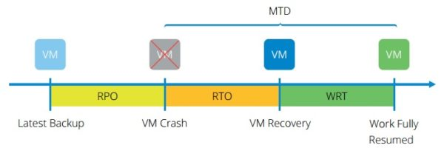
RTO, RPO, WRT, MTD - Ilustration
Imagine a system goes down at 09:00 AM.
Concept | Meaning | Example
RPO | How much data loss is acceptable? | RPO = 2 hours → data up to 07:00 must be safe
RTO | How fast IT must restore the system | RTO = 4 hours → system must be up by 13:00
WRT | Time for business to resume fully after IT recovery | WRT = 2 hours → ready by 15:00
MTD | Total downtime allowed | MTD = 6 hours

Slide 33
Preventive Strategies
Preventive Strategy | Brief Explanation | Example
Redundant Systems | Duplicate critical components so if one fails, another takes over. | Using two database servers in a cluster so service continues if one crashes.
UPS and Generators | Provide backup power to keep systems running during power outages. | A data center switches to UPS instantly, then to generators within minutes.
Network Failover | Automatic switch to an alternate network path or ISP when primary link fails. | Internet traffic reroutes to a backup link when the main ISP goes down.
Hardening Infrastructure | Strengthening systems to reduce vulnerabilities or failures. | Disabling unused ports/services, applying secure configs, enforcing strong access controls.
Patch Management | Regularly updating systems to fix known security and stability issues. | Applying OS and application patches monthly to prevent exploits or software crashes.

Slide 34
Detective Strategies
Detective Strategy | Brief Explanation | Example
Monitoring Tools | Systems that continuously watch performance, availability, and health of IT components. | A monitoring dashboard alerts when CPU usage spikes or a server stops responding.
Intrusion Detection | Tools that detect suspicious or malicious activity in networks or systems. | IDS detects unusual traffic patterns indicating a potential attack.
Log Analysis | Reviewing system, application, or security logs to spot anomalies or issues. | Automated log analyzer flags repeated failed login attempts.
Alerting Mechanisms | Notifications triggered when predefined thresholds or events occur. | SMS/email alerts sent to admins when the database server goes down.

Slide 35
Corrective / Recovery Strategies
Enable recovery after incident:
Backups (full, incremental, differential)
Replication (synchronous, asynchronous)
Alternate sites (hot, warm, cold)
Cloud disaster recovery
Manual workarounds

Slide 36
Backup Strategies
Backup Type | What It Does | Advantages | Limitations | Simple Example
Full Backup | Copies all data every time. | Easiest to restore; complete copy. | Slow; uses most storage. | Full backup done every Sunday.
Incremental Backup | Backs up only data changed since the last backup (full or incremental). | Fastest, least storage. | Restore requires the full + all incrementals; slower recovery. | Daily incremental after Sunday full.
Differential Backup | Backs up all data changed since the last full backup. | Faster restore than incremental (need only full + latest differential). | Larger storage than incremental; grows each day. | Wednesday differential includes all changes since Sunday.

Slide 37
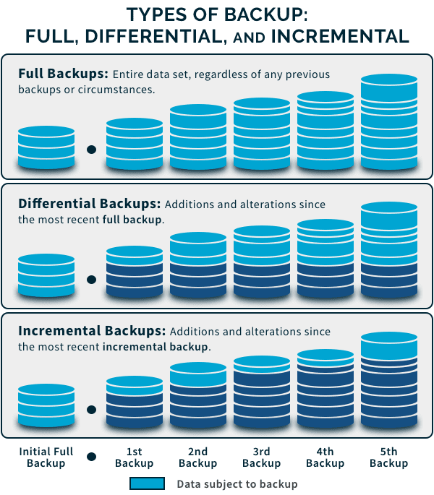
Source: https://www.spanning.com/blog/types-of-backup-understanding-full-differential-incremental-backup/

Slide 38
Replication Types
Replication Type | How It Works | Recovery Speed | RPO Impact | Example
Synchronous Replication | Data is written to primary and replica at the same time; transaction completes only after both succeed. | Fastest; almost immediate failover. | Near-zero data loss. | Banking systems requiring no transaction loss.
Asynchronous Replication | Primary writes first, then sends data to replica with a delay. | Fast, but with slight lag. | Some data loss possible (seconds to minutes). | DR site updated every few seconds for a retail system.

Slide 39
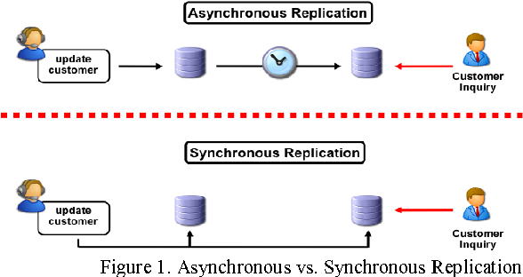
Replication Types
Source: https://figures.semanticscholar.org/5e21d4fb70e4b6bcc8c84e9384d5e35c9496d6f5/2-Figure1-1.png

Slide 40
Alternate Sites
Alternate Site Type | What It Provides | Recovery Time | Cost | Key Characteristics | Example
Hot Site | Fully equipped facility with hardware, network, near-real-time data. | Hours or less. | High. | Ready to operate immediately; supports critical systems. | Financial institution failover center.
Warm Site | Partially equipped site with hardware and connectivity, but requires setup and data restoration. | Hours to days. | Moderate. | Some configuration needed after activation. | Insurance company with pre-installed servers but no live data.
Cold Site | Empty facility with power and basic environment; no equipment installed. | Days to weeks. | Low. | Requires bringing hardware, installing systems, restoring data. | Government office with rental space reserved for emergencies.

Slide 41
Types of BCP/DRP Tests
Test Type | Brief Explanation | Example
Checklist Review | Reviewing the plan on paper to confirm accuracy of contacts, procedures, and resources. | Team checks whether the phone list, vendor info, and backup inventory are up to date.
Tabletop Exercise | Key personnel discuss what they would do in a hypothetical incident. No technical action. | Managers walk through how they would respond to a cyberattack scenario.
Simulation Test | Staff practice recovery steps in a simulated or test environment without affecting production. | IT simulates a server crash and restores it in a test lab.
Parallel Test | DR systems are activated and run side-by-side with production to confirm they work. | The DR database is restored and run parallel to the live DB to compare results.
Full Interruption Test | Production is shut down and operations fully move to the recovery site. | The organization powers down the primary data center and operates completely from the DR site.

Slide 42
Maintaining the Plan
Update after system changes
Include contact lists, vendor info, network diagrams
Review test results → lessons learned
Ensure business and IT alignment
Involve senior management & key stakeholders

Slide 43
Auditor Responsibilities
#goingWell

Slide 44
What the IS Auditor Must Evaluate
IS auditors must verify that:
BIA is performed correctly
Recovery metrics are realistic and approved
Controls exist for continuity and recovery
Plans are documented, updated, and tested
Backup procedures are well-designed and monitored
Roles & responsibilities are clear
Alternate sites and service providers can meet requirements

Slide 45
What Auditors Check
BIA completeness
Critical processes identified
RTO, RPO, WRT, MTD are defined and realistic
Continuity & recovery plans
BCP, DRP, ITSC plans documented
Roles and responsibilities assigned
Technical controls
Backups (process, frequency, integrity checks)
Redundancy, failover, alternate sites
Testing & maintenance
Regular tests performed (tabletop → full test)
Issues tracked and improvements implemented
Alignment & governance
Plans match business priorities
Senior management approval and oversight

Slide 46
Assignment V – Fill-up Domain 4!
We might do the previous quiz again later.
So let’s start filling up our mind-map again ☺
The Top 4 of in-class Domain 4 quiz would be the group leader.
Let’s draft the dream team!

